Slide 1
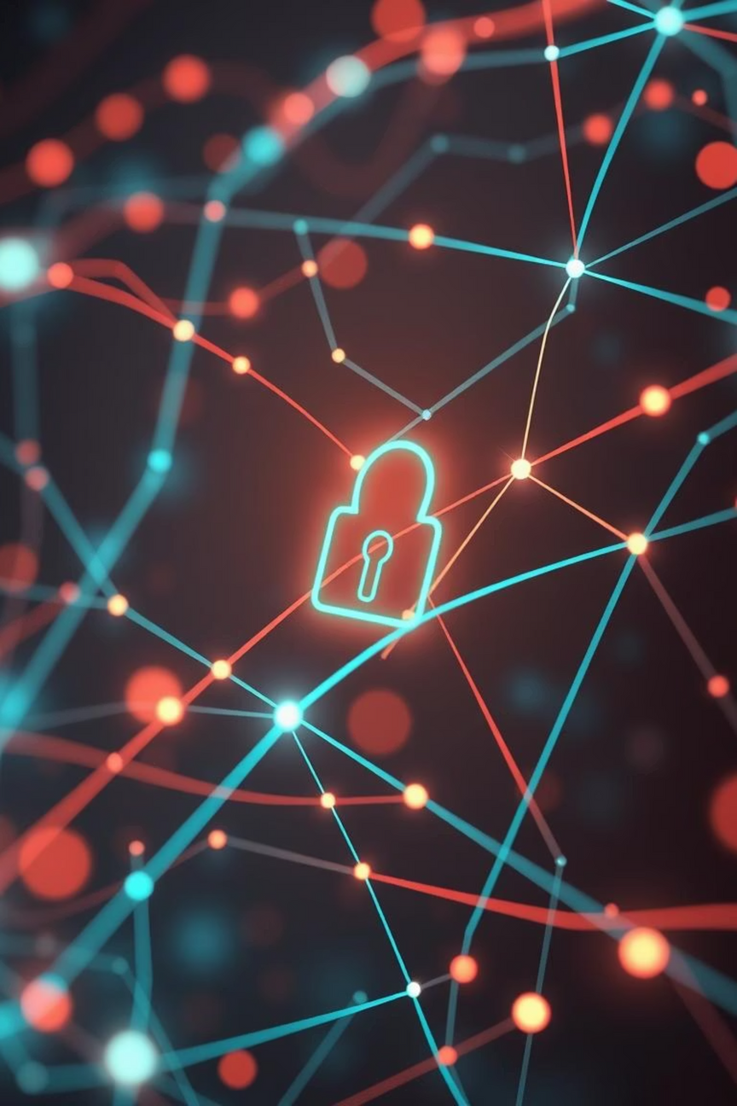

Phishing Awareness Training: Fortifying Our Digital Defenses
Presented by: [Akash Bhat]
Date: [28/06/2025]
Notes:
1

Slide 2
Learning Objectives
1
Define Phishing and its Forms
Understand what phishing is, its various types, and how it can impact individuals and organizations.
2
Identify Common Red Flags
Learn to recognize the tell-tale signs of phishing attempts in emails, messages, and websites.
3
Comprehend Social Engineering Tactics
Gain insight into the psychological manipulation techniques used by attackers to trick victims.
4
Apply Best Practices for Prevention
Acquire practical steps and defensive measures to protect yourself and the company from phishing attacks.
5
Practice Recognition Skills
Test your knowledge with interactive quizzes and real-world scenarios to solidify your understanding.
Notes:
2

Slide 3

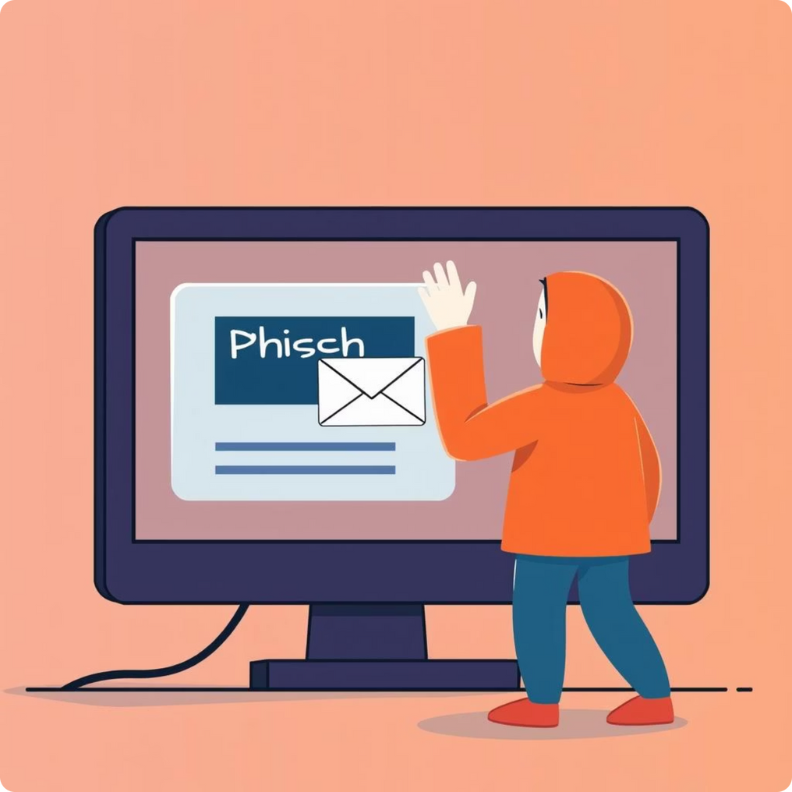
Introduction to Phishing: The Digital Lure
Phishing is a cybercrime where criminals pose as legitimate organizations to trick people into sharing sensitive data like passwords and financial information. It started in the 1990s as hackers "fishing" for this data.
Globally, the average cost of a data breach in 2023 was an estimated $4.45 million, a 15% increase over three years. Phishing remains a primary initial attack vector, responsible for a significant portion of these breaches, leading to substantial financial losses and reputational damage.
Case Study: The "Urgent Invoice" Scam
A mid-sized logistics company recently fell victim to a sophisticated phishing attack. An employee received an email, seemingly from a long-term supplier, with an "urgent invoice" attached. The email had subtle grammatical errors and a slightly off-domain sender address. The employee, under pressure, clicked the link, leading to malware deployment and a significant data exfiltration incident costing the company over $500,000 in recovery efforts.
Notes:
3

Slide 4
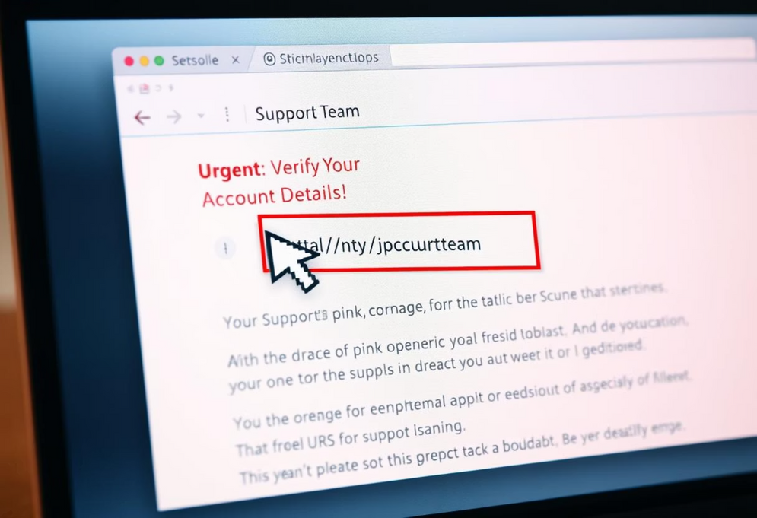
Anatomy of a Phishing Email
Phishing emails are crafted to look legitimate, but they often contain subtle clues that reveal their malicious intent. Being able to spot these elements is crucial for your defense.
Sender Address Tricks: Attackers often use email addresses that are similar to legitimate ones, but with minor alterations (e.g., "support@companyy.com" instead of "support@company.com"). Always inspect the full email address, not just the display name.
Display Name Spoofing: The "sender name" might appear correct (e.g., "CEO John Doe"), but the actual email address, when expanded, will reveal a suspicious domain.
"Reply-To" Mismatch: Sometimes, even if the "From" address looks legitimate, the "Reply-To" address (where your reply would go) is malicious. Always check this before responding.
Visual Example: Hover vs. Click Always hover your mouse pointer over any link in an email without clicking. This will usually reveal the true destination URL in the bottom-left corner of your email client. If the displayed URL doesn't match the expected destination, it's likely a phishing attempt.
Urgency and Fear Tactics: Phishing emails often create a sense of urgency or fear ("Account will be suspended!", "Immediate action required!") to pressure you into acting without thinking.
Notes:
4

Slide 5
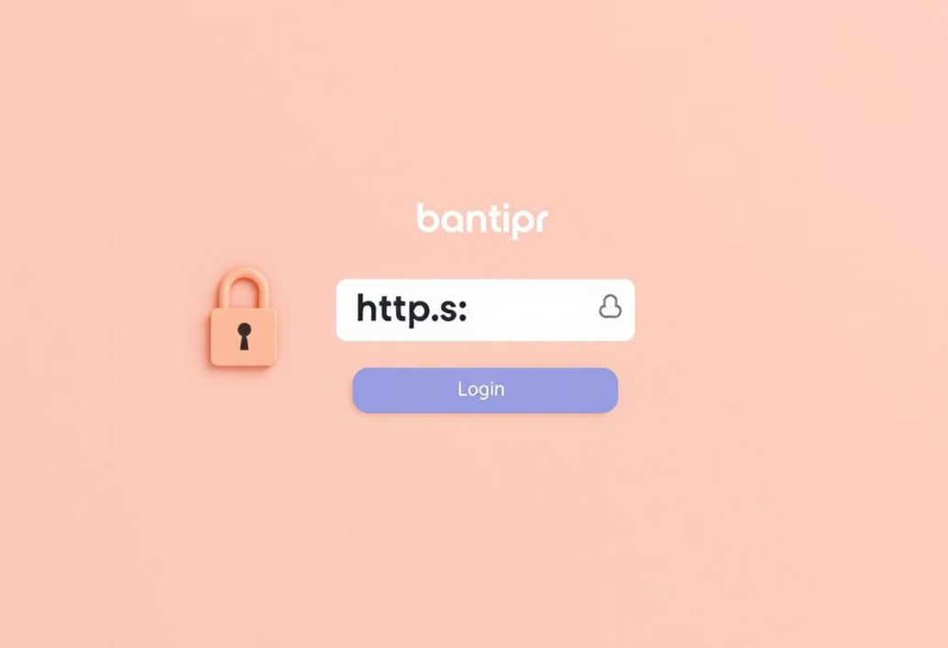
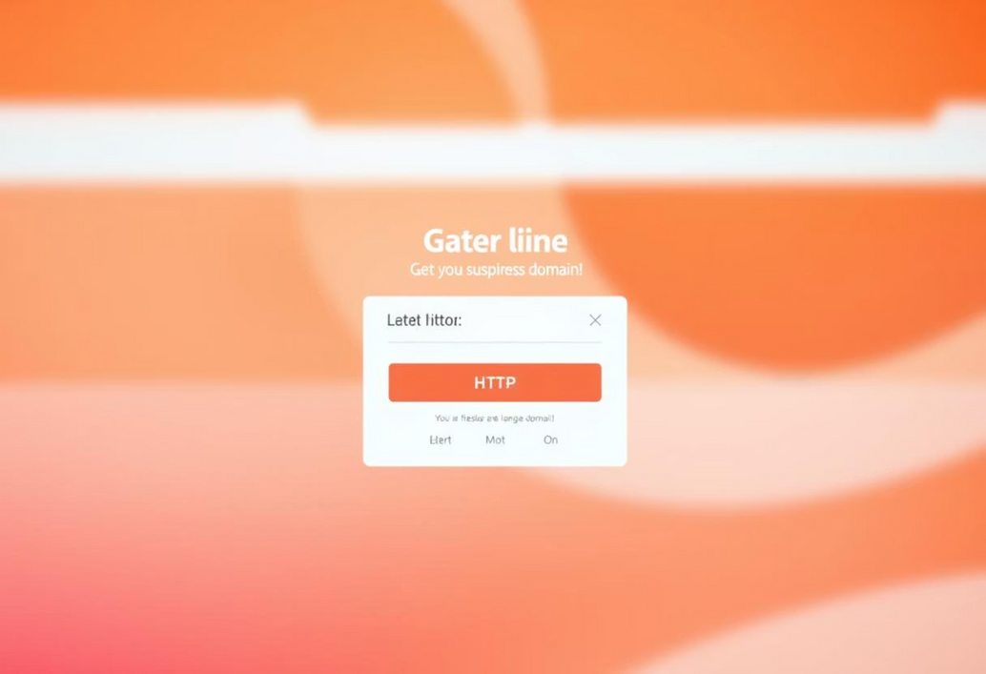
Recognizing Fake Websites
Phishing attempts often direct you to fake websites designed to steal your credentials or personal information. These sites mimic legitimate ones but contain subtle errors.
Legitimate Website Example
Phishing Website Example
Odd or Suspicious Domains
Misspellings & Grammatical Errors
Missing SSL Padlock / HTTPS
Legitimate sites, especially those requiring login, use HTTPS (Hypertext Transfer Protocol Secure), indicated by a padlock icon in the browser's address bar. If it's missing or says "Not Secure", be cautious.
Check the URL for strange characters, extra words, or incorrect top-level domains (e.g., .net instead of .com).
Legitimate websites rarely contain typos or poor grammar. Scammers often overlook these details.
Notes:
5

Slide 6




Social Engineering Techniques
Attackers use social engineering – manipulating people into performing actions or divulging confidential information – to enhance their phishing attempts.
Creating a fabricated scenario to engage a target, often involving a false identity or a specific problem to solve (e.g., "I'm calling from IT, we detected unusual activity on your account").
Pretexting :
Highly targeted phishing attacks customized for a specific individual or organization, often leveraging publicly available information or internal data for credibility.
Spear Phishing :
A type of spear phishing that specifically targets high-profile individuals within an organization, such as executives or senior managers, often impersonating a peer or superior for financial gain or sensitive data.
Whaling :
Scammers exploit inherent human tendencies. They often use authority (impersonating a boss or government official), scarcity (limited-time offers), and urgency (act now or lose access) to bypass rational thought.
Psychological Triggers:
Notes:
6

Slide 7
Best Practices & Defensive Measures
Vigilance is Key
Technical Defenses
Hover Before You Click: Always preview links by hovering your mouse over them to check the actual URL.
Enforce Multi-Factor Authentication (MFA): MFA adds an extra layer of security, making it harder for attackers to access accounts even if they steal your password. Always enable it where possible.
Verify Sender: If an email seems suspicious, especially if it asks for sensitive information or actions, verify the sender through an independent, trusted channel (e.g., call them on a known number, don't use a number from the email).
Keep Software Updated: Regularly update your operating system, web browsers, and all applications. Updates often include security patches for known vulnerabilities that attackers exploit.
Be Skeptical of Urgency: Any message demanding immediate action or threatening consequences should be treated with extreme caution.
Use Antivirus/Anti-Malware Software: Ensure your devices have up-to-date security software that can detect and block malicious content.
Company-Specific Reporting Steps: If you suspect a phishing attempt, do NOT click any links or open attachments. Forward the suspicious email as an attachment to security@yourcompany.com and then delete it. For urgent concerns, contact the IT Help Desk immediately.
Notes:
7

Slide 8
Conclusion
Strengthen Your Cyber Awareness:
Phishing attacks aren’t just technical threats — they’re psychological tricks designed to bypass our instincts. Staying informed is your best defense.
🧠 Stay Vigilant: Be skeptical of urgent, unexpected, or suspicious messages — even if they appear to come from someone you know.
🕵️‍♂️ Verify Before You Trust: Always double-check links, email addresses, and sender identities through independent channels.
🚨 Report Immediately: Don’t ignore your gut. If something feels off, report it to the IT Security Team without delay.
🔐 Adopt Strong Security Habits: Use multi-factor authentication, keep your devices and software updated, and install trusted security tools.
Every employee plays a critical role in protecting our organization’s digital integrity. Your vigilance helps prevent costly breaches, protects sensitive data, and strengthens our overall security posture.
Cybersecurity is everyone’s responsibility. Together, we can build a safer digital workplace.
Thank you for your attention — and your commitment to cybersecurity
Notes:
9

